Slide 1
MGMT590 - Visual Analytics
Session 10
Dr. Cecilia Ying
Updated: 10/01/2025

Slide 2
Today’s Agenda
Session 10
Reminder, Assignment 2 is due this Friday, Oct 3rd, at 11:59 pm.
Project Presentation Details
Special graphs “show and tell”
Kahoot
Hands-on Exercise
Cluster visual analytics – Unstructured Data
4. Assignment 2 working session

Slide 3
Project Presentation – Next Week
6 teams for each class
Each team will have 15 minutes
5 minutes for context
5 minutes “Killer figure” & pitch
5 minutes Q&A
The rest of the class will act as the CTO and ask questions
You will vote for one project you would like to fund
Bonus points:
The team that got the most votes from the class will get 5% bonus on their project grade.
One vote per person
You cannot vote for your own team
3% bonus points for creative/ fun/ coordinated team outfits (i.e., matching bow ties? Ya!)

Slide 4

Special Graph “Show and tell” – Last chance!

Slide 5


Game on… Final round!!!
Winner takes all!
Go to https://kahoot.it/ or open the Kahoot mobile app and tap Join
Enter the game PIN
Enter your name and join

Slide 6
Hands-on Practice
Clusters

Slide 7


Turning unstructured to structured
OK, but HOW?

Slide 8

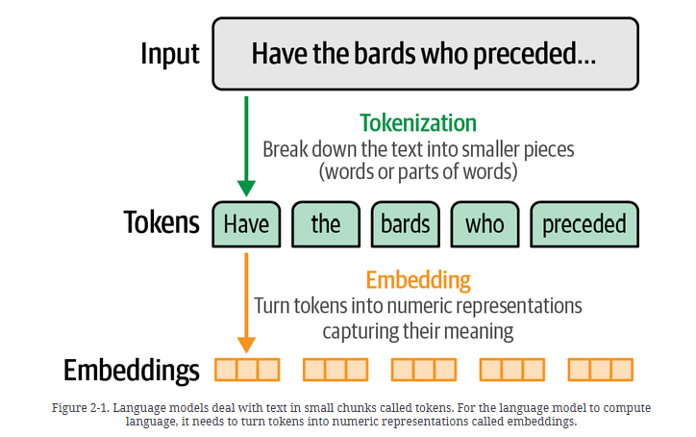
A simple two-step process
Tokenization and Vectorization
Step 1: Tokenization
Step 2: Vectorization (Embeddings)
Divides the texts into “tokens”. This determines the “vocabulary” of the dataset/corpus (i.e., a set of unique tokens present in the data)
Define a good numerical representation to characterize each token
Source: Hands-On Large Language Models

Slide 9
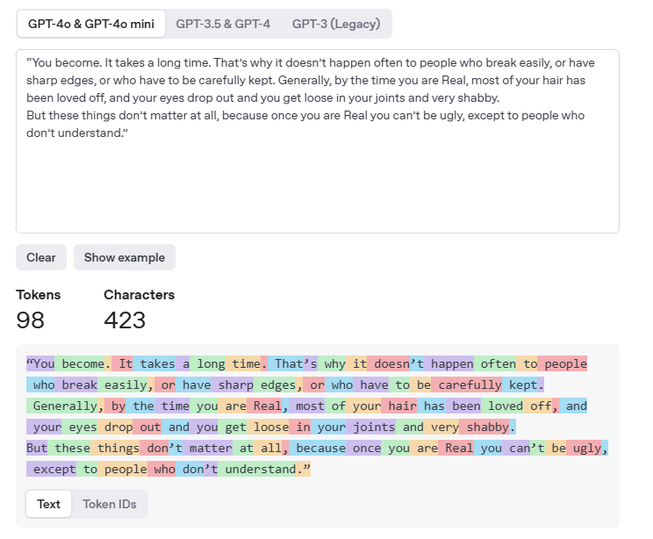

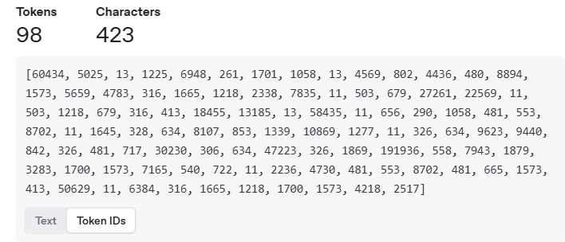
Tokenization
Paragraphs, sentences, and words
Test it yourself: https://platform.openai.com/tokenizer

Slide 10
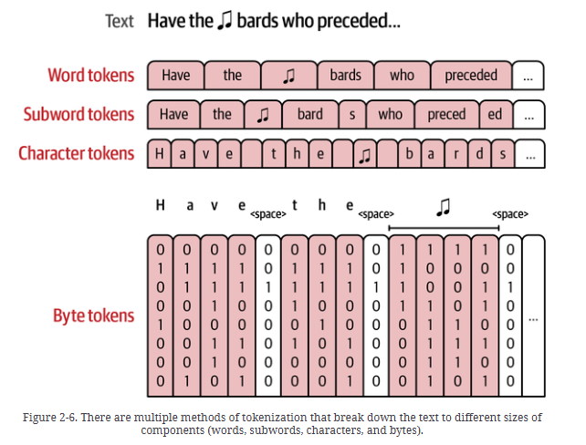
Tokens come in all different shapes and sizes
Sentence, word, subword, character…
Basically, the tokenization step assigns a unique ID to each token (chunk of word(s))
Different tokenizers handle various kinds of tokens differently, for example: 1. Capitalization
2. Emojis
3. Numbers and digits

Slide 11
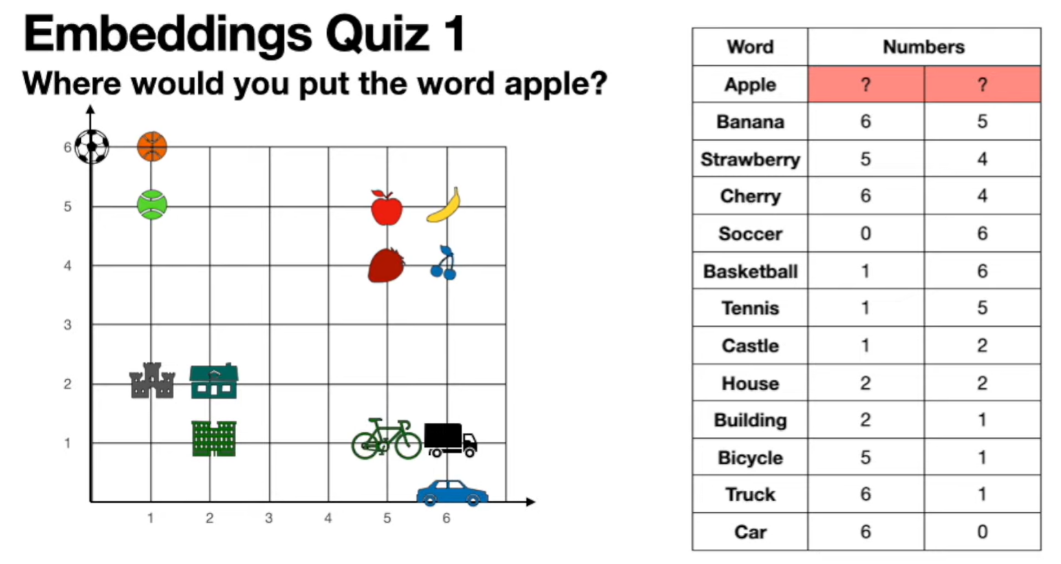



Quick Detour: Embeddings and beyond
What if we add “Orange”?
Translating each token into a numerical representation

Slide 12
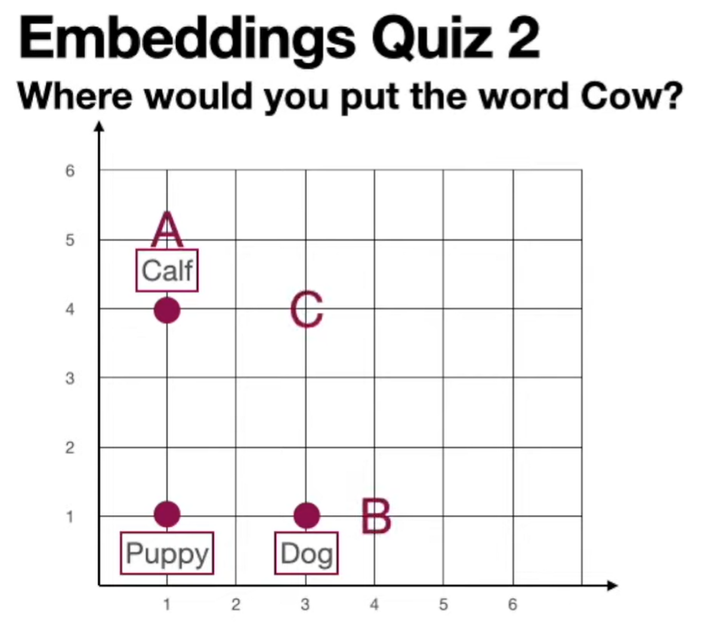
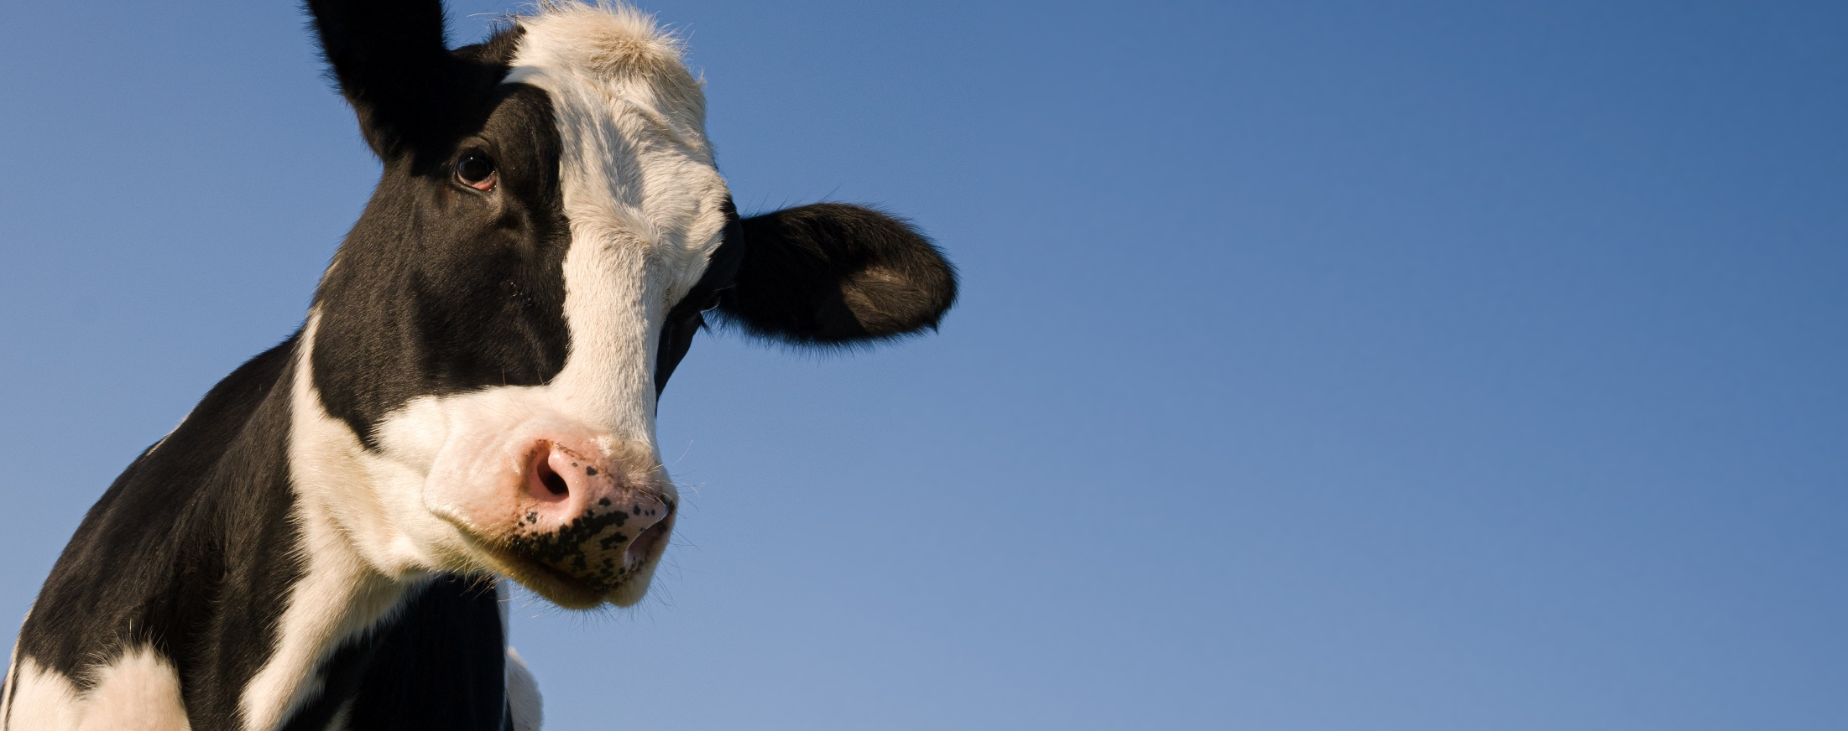
Where would you put the “Cow”?
A, B or C?
Species of the animals (y-axis):
A puppy to a dog is like a calf to a cow.
Age of the animals (x-axis):
A puppy to a calf is like a dog to a cow.

Slide 13
Visual Analytics: Unsupervised ML on Structured Data
What is clustering?
Unsupervised Clustering
Groups similar data points together automatically
No labels or pre-defined categories needed
Algorithm finds hidden patterns on its own
Examples: customer segments, document categories, image grouping

Slide 14
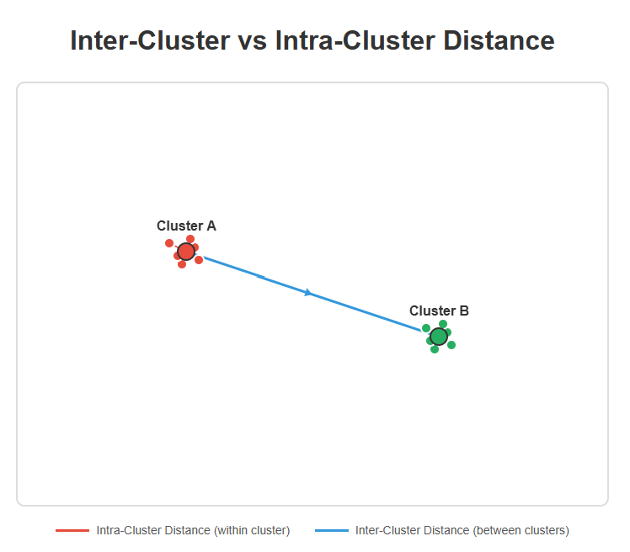
Some technicalities on Distance Measure
Intra-cluster distance vs. Inter-cluster distance
Intra-Cluster (within cluster)
Measures how close data points are to each other within the same cluster
Calculated as the distance from each point to its cluster center (centroid) or to other points in the same cluster
Small intra-cluster distance = similar customers grouped together
Goal: Minimize this distance (i.e., tight, compact clusters)

Slide 15
Some technicalities on Distance Measure
Intra-cluster distance vs. Inter-cluster distance
Inter-Cluster (between cluster)
Measures how far apart different clusters are from each other
Calculated as the distance between cluster centers or between the closest/ farthest points of different clusters
Goal: Maximize this distance (well-separated clusters)
Large inter-cluster distance = distinct, different customer segments

Slide 16
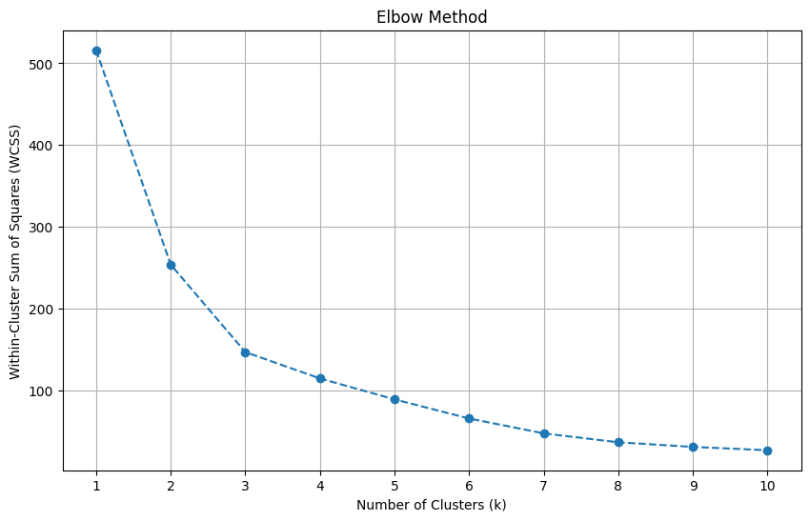
Determine how many clusters
Within-Cluster Sum of Squares (WCSS) or inertia
What WCSS Measures
Total sum of squared distances of all intra-cluster
How the Elbow Method Works?
Run clustering with different values of k (e.g., k = 1, 2, …, 10)
Lower WCSS = tighter, more compact clusters
Calculate WCSS for each k
Plot WCSS vs. k
Look for the “elbow” where the curve bends sharply and WCSS stops decreasing dramatically
Why is there an “Elbow”?
As k increases, WCSS always decreases (more clusters = tighter fit)
As some point, adding more clusters gives diminishing returns
The elbow point is where you get the best balance between simplicity (fewer clusters) and fit (lower WCSS)

Slide 17

Code Demo – Clustering on Unstructured Data
https://colab.research.google.com/drive/1YfTlJoD7xUCxQtQgL44L1irwcGB-iyWn?usp=sharing

Slide 18
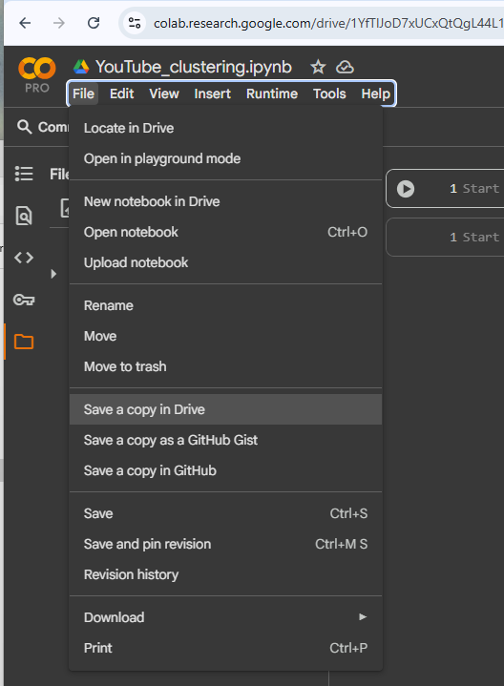
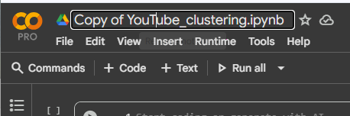



First, save a copy and rename
Once you click “Save a copy in Drive”
A new window will open with “Copy of…”
Here you can rename your notebook

Slide 19
Here’s the roadmap
Easy as 1, 2, and 3…
Extract topics from “title”
Unsupervised clustering (based on relevant features)
Visualize cluster results

Slide 20
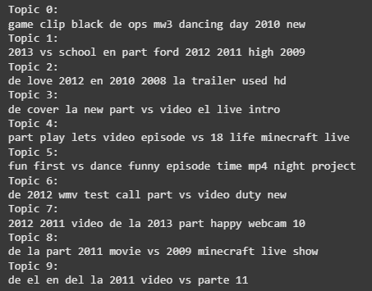
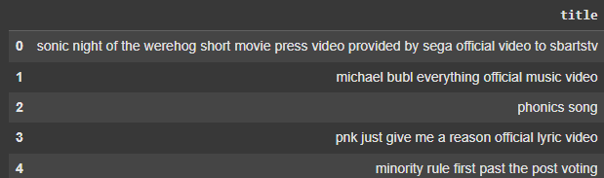
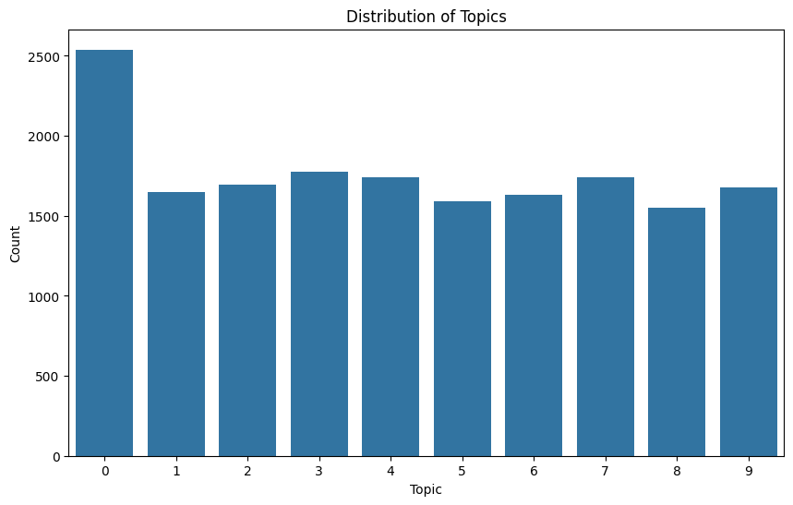

Step 1: Topic Modeling
Extract topics from “title” using LDA (latent Dirichlet allocation)
What information can we extract from “title”?
Ten common topics extracted from “title”

Slide 21
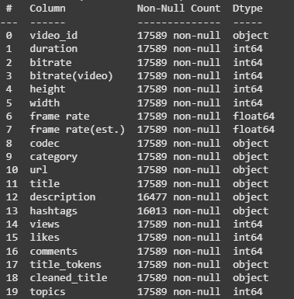
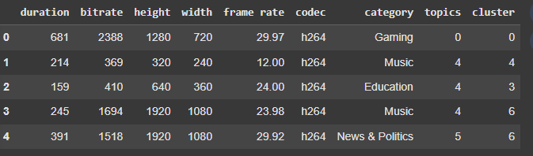


Step 2: Unsupervised Clustering
Select features to use for clustering
So here are the ones I selected for my clustering model
Here is the cluster assignment for each data point
Now, instead of only using the structured data (i.e., duration, bitrate, frame rate etc.), we can include topics extracted from titles to form our clusters

Slide 22
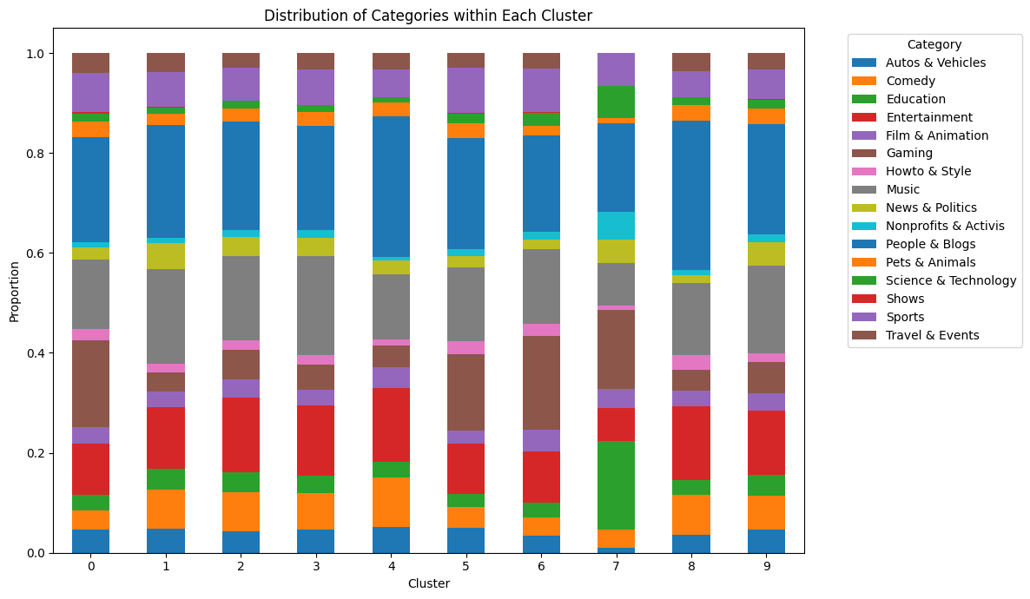
Step 3: Visualize Cluster Assignments
Distribution of categories within each cluster

Slide 23
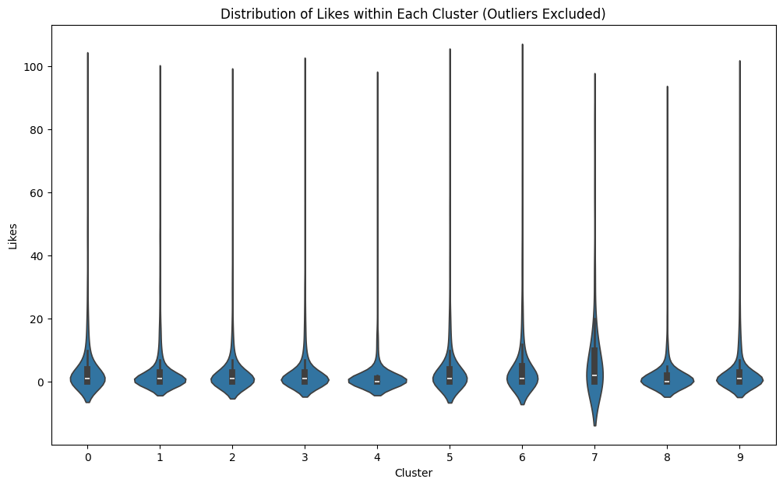
Step 3: Visualize Cluster Assignments
Distribution of likes within each cluster

Slide 24
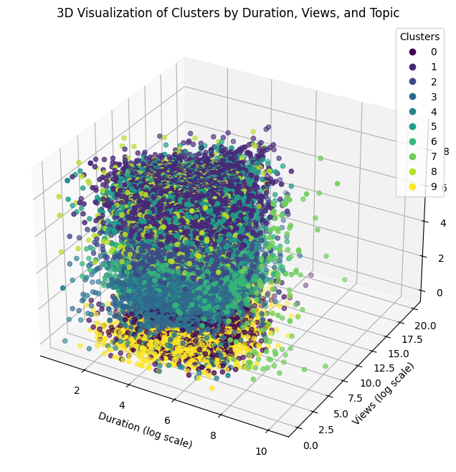
Step 3: Visualize Cluster Assignments
Duration, Views, and Topics

Slide 25
Now let’s try this on “description”
Your task is to:
Find topics from “description”
Select a subset of features you think are useful for finding similar videos to predict “likes” or “views” to form your clusters.
Include topics extracted from “description” as one of your features
Exclude “likes” and “views”
Visualize the clusters and try to see if there are any clear signals of key drivers for “likes” or “views”

Slide 26
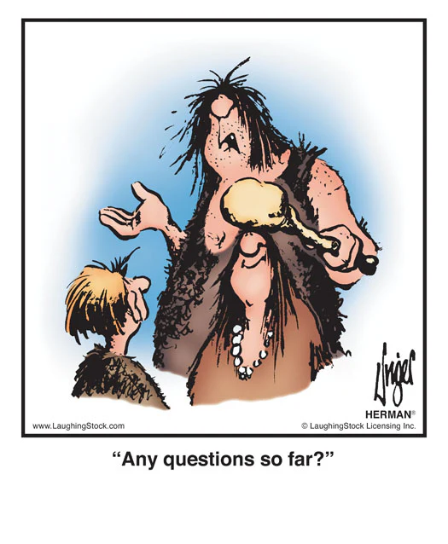
Questions?

Slide 27

That’s a wrap

Slide 28
Assignment 2
Crafting and articulating that Compelling Story

Slide 29
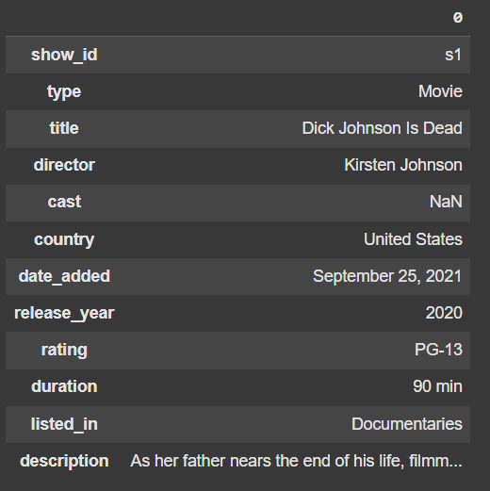
Dataset
https://www.kaggle.com/datasets/shivamb/netflix-shows
About this Dataset: Netflix is one of the most popular media and video streaming platforms. They have over 8000 movies or TV shows available on their platform. As of mid-2021, they have over 200 million subscribers globally.
This tabular dataset consists of listings of all the movies and TV shows available on Netflix, along with details such as cast, directors, ratings, release year, duration, etc.

Slide 30
Context
Counter the threat of GenAI-generated movies: a study of Rajiv Chilaka vs. Martin Scorsese
You have been hired by a cool animation startup in LA to draw insights from the works of Rajiv Chilaka and Martin Scorsese based on the data available in this dataset.
You will then use these insights to recommend strategies for them to counter the threat of GenAI-generated movies.

Slide 31
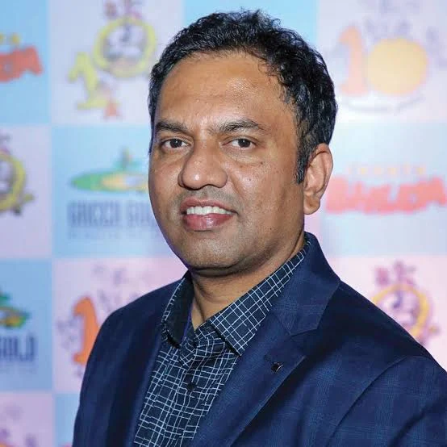
Rajiv Chilaka
Highest number of directed movies in the dataset
Rajiv Chilaka is an Indian animation filmmaker known for his work on shows like “Chhota Bheem” and “KikoRiki”.

Slide 32

Martin Scorsese
You know… the guy who directed Goodfellas, The Departed, The Irishman, etc.
Martin Scorsese is an American film director known for his gritty, intense films like “Goodfellas”, “The Departed”, and “The Irishman”.

Slide 33
Deliverables
Executive Summary & Supporting Analysis
A one-page executive summary detailing the analysis, insights, and recommendations.
One killer figure.
Additional supporting analysis can be included as an appendix.

Slide 34
Grading Criteria
How well can you craft and articulate the story
Crafting the Compelling Story (50%)
Depth and relevance of insights drawn from the data analysis
Articulating the Compelling Story (50%)
Clarity, coherence, and organization of the executive summary
Effectiveness of recommendations for countering GenAI threats
Originality and creativity of the approach
Ability to identify and leverage key relationships, trends and patterns in the data
Use of effective visualizations to support findings and recommendations
Ability to communicate complex ideas and insights in a clear and concise manner

Slide 35
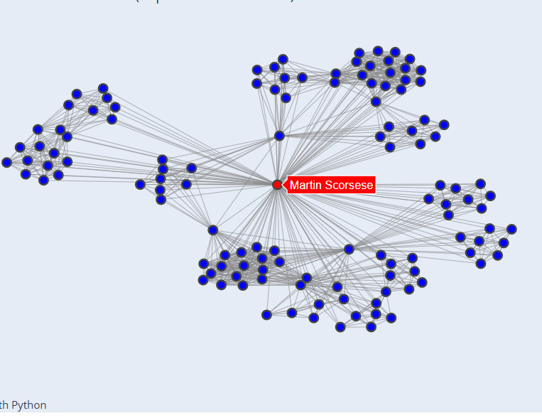
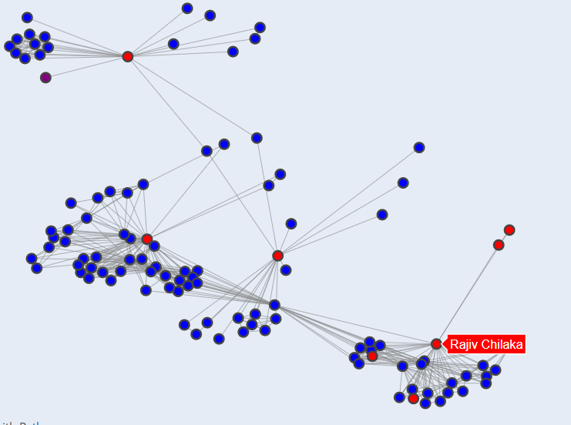
Network analysis
Who are these guys working with?
More on this next week

Slide 36
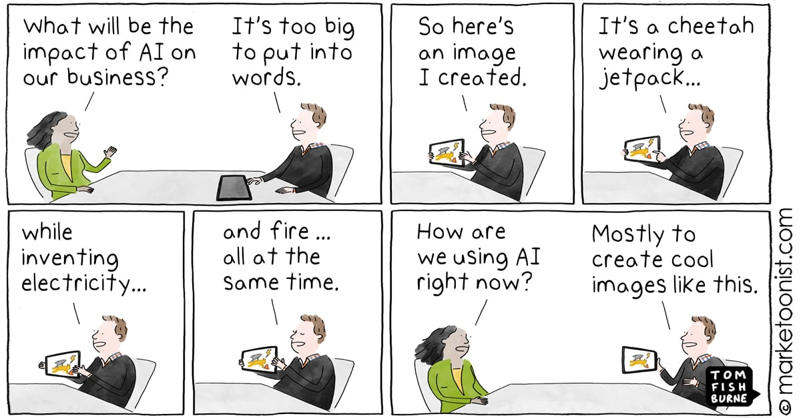

Slide 37
Team Project
Building your “killer figure”

Slide 38
Team Project Description
Building your “killer figure”
Context
You are pitching a business case to a group of senior technology executives at your company, but a call came in, and the CTO will have to leave the meeting in 5 minutes.

Slide 39
Team Project Description
Building your “killer figure”
Challenge
You have 5 minutes to summarize your key findings, assumptions, and/or projections to convince your CTO that YOUR project is worth funding.

Slide 40

Ryan Buell’s famous “Killer Figure”
Professor from Harvard Business School https://www.hbs.edu/faculty/Pages/profile.aspx?facId=320524
“You should be able to summarize your entire presentation using ONE KILLER FIGURE.”

Slide 41
Team Project Description
Building your “killer figure”
Your Tasks
Identify a domain that is interesting to your team.
Find a dataset in that domain (common places to look: HuggingFace, Kaggle, UCI, Papers with Code)
Craft a project idea based on the data you are using (more on the next slide)
Create one killer figure that clearly tells your story
5-minute in-class presentation using the killer figure

Slide 42
Team Project Description
Building your “killer figure”
Project Objectives
Crafting a compelling story with data
Clearly articulate that story with one killer figure
Be creative and have fun

Slide 43
Team Project Description
Building your “killer figure”
Crafting Your Idea
What problems are you trying to solve?
What questions are you trying to answer?
What kind of data will you need?

Slide 44
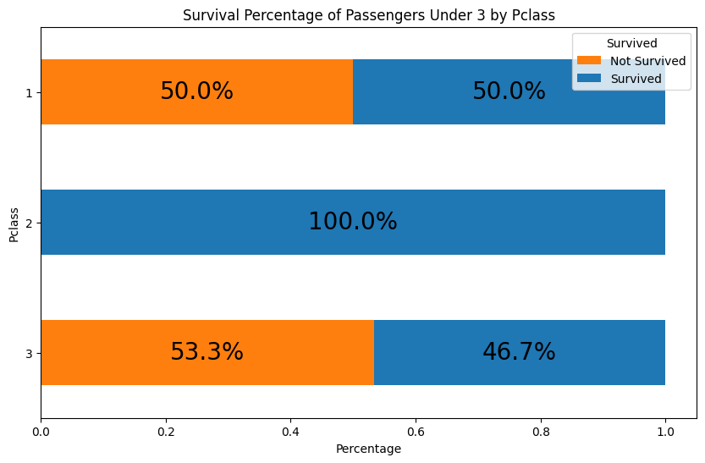
Team Project Description
Building your “killer figure”
Punchline:
The first-class children have only a slightly higher survival percentage (50%) than the third-class children (46.7%)!

Slide 45
Team Project Description
Building your “killer figure”
The first-class children pay, on average $151, which is 6 times higher than third-class children, who pay, on average $23. And yet, the company failed to ensure their safety.
Business proposal to
Improve the overall survival percentage for all children.

Slide 46
Team Project Description
Building your “killer figure”
Watch this video for inspiration (as needed)
How Consulting Firms Make Complex Topics Simple
Analyst Academy

Slide 47
Common Data Sources
Some recommendations
Huggingface: https://huggingface.co/docs/datasets/en/index
Kaggle: https://www.kaggle.com/datasets (Here you will also easily find code/notebooks from others, but be careful when using someone else's code - it might take more time to debug than write your own)
UCI: https://archive.ics.uci.edu/datasets
Papers with code: https://paperswithcode.com/datasets (this one is great if you want to read the research that's been done on the particular dataset)

Slide 48

Questions?

